Slide 1

Case Study 2: Employee Data Analysis Lijo Jacob Apr 07, 2023
DDS Analytics

Slide 2


Project analysis slide 2
Agenda
OVERVIEW
TOP FACTORS
MODELS & PREDICTIONS
JOB ROLE & OTHER TRENDS
RECOMMENDATIONS & SUMMARY

Slide 3

Project analysis slide 3
Overview
ATTRITION ANALYSIS
MONTHLY INCOME ANALYSIS
EMPLOYEE DATA
Features considered are Work Life Balance, Job Involvement, Job Satisfaction, Over Time, Job Level, Environment Satisfaction, Number of Companies Worked, Total Working Years & Marital Status
Method used for Top Feature Selection: Linear Regression & t-test
Features considered are Department, Job Role, Job Level, Total Working Years, Age, Education, Years At Company, Years In Current Role, Years With Current Manager
Method used for Top Feature Selection: Correlation Matrix using ggcorrplot, Linear Regression & t-test
870 observations
36 features
No Missing data
Data includes factors and integers

Slide 4
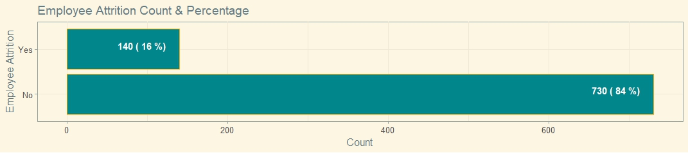
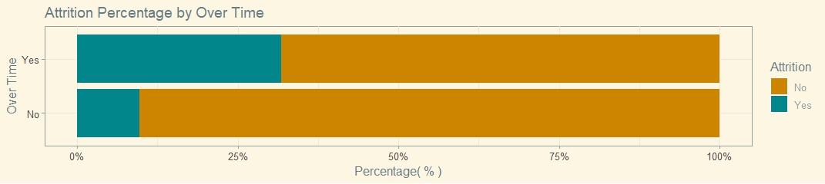
Project analysis slide 4
Attrition
Top 3 Factors
Over Time
Job Involvement
Total Working Years

Slide 5
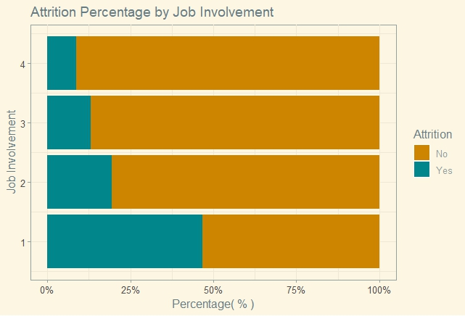
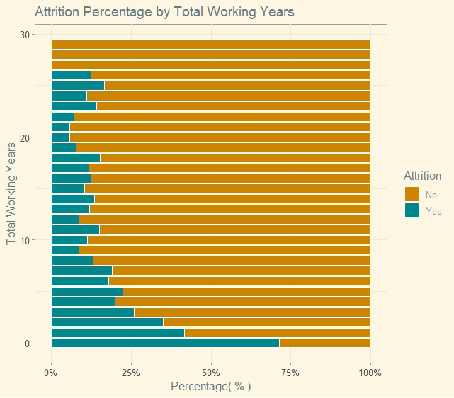
Project analysis slide 4
Top 3 Factors(Continued)

Slide 6
Project analysis slide 4
Attrition: Model & Classification
Predictors | Over Time, Job Involvement, Total Working Years
Response | Attrition
Best Model | K-Nearest Neighbor(KNN) Model
Mean Accuracy | 75%
Mean Sensitivity | 81%
Mean Specificity | 71%

Slide 7
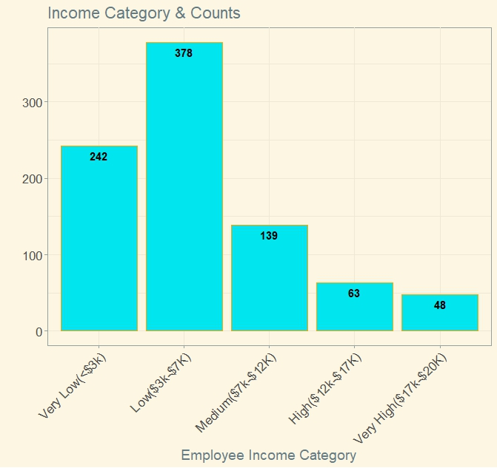
Project analysis slide 4
Monthly Income
 | Monthly Income
Min | $1,081
Median | $4,945
Mean | $6,390
Max | $19,999
Most of the Employees are in the income categories ‘Low’ and ‘Very Low’

Slide 8
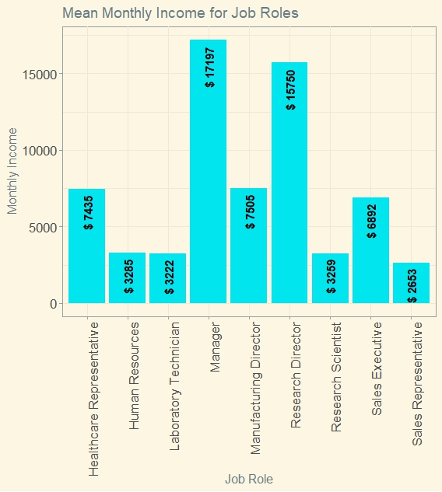
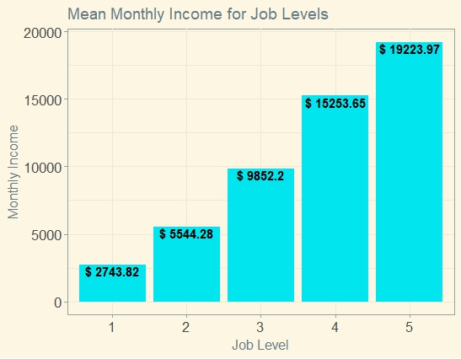
Project analysis slide 4
Top 3 Factors
Job Level
Job Role
Total Working Years

Slide 9
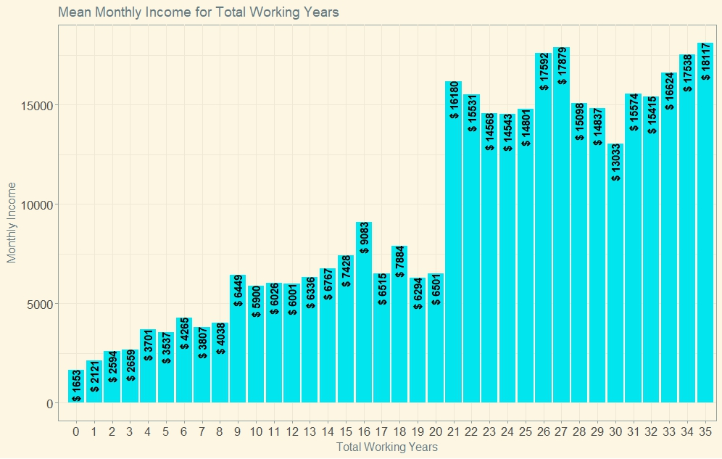
Project analysis slide 4
Top 3 Factors(Continued)

Slide 10
Project analysis slide 4
Monthly Income: Model & Classification
Predictors | Job Level, Job Role, Total Working Years
Response | Monthly Income
Model | Linear Regression Model
RMSE | $1056.00

Slide 11
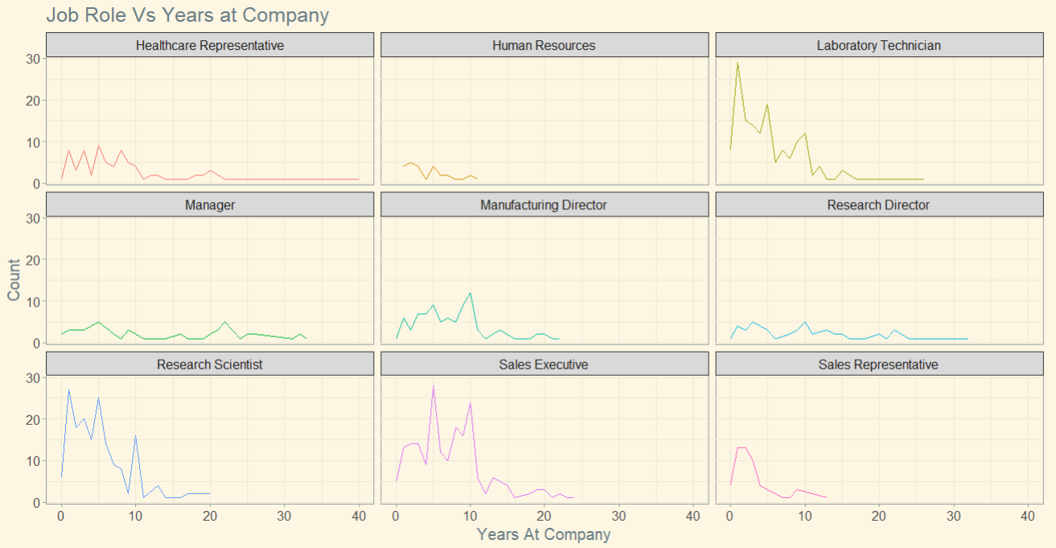
Project analysis slide 5
Job Role Trends
For various Job Roles as shown below data suggests that most of the employees are leaving the company within first 10 years with exceptions to the Job Roles such as ‘Manager’ and ‘Research Director’

Slide 12
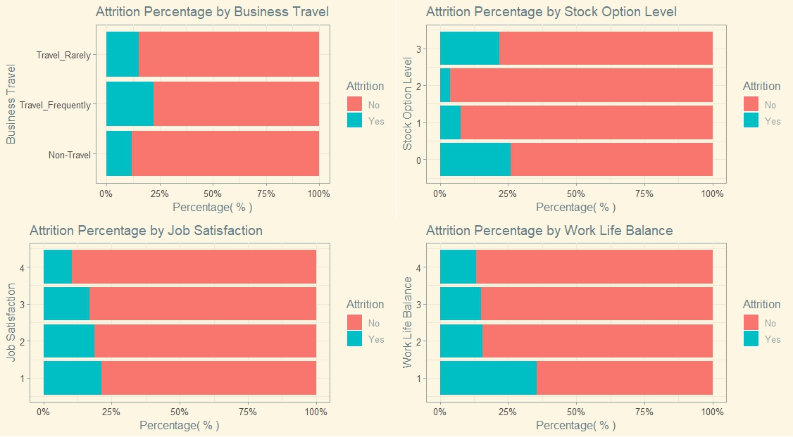
Project analysis slide 5
Other Trends
Evidence suggests that
Employees who travel frequently as part of their job are likely to leave the company more often
Employees who have no stock options tend to leave the company more often
Other factors such as low job satisfaction and low work life balance force employees to leave the company

Slide 13
Project analysis slide 6
Recommendations
To retain employees, Company should
Provide required compensation to employees who do over time or travel frequently.
Provide basic stock option (1)
Newly joined(< 1 year) employees should be provided with perks, recognition and rewards
Figure out the more common issues related to low job involvement and low work life balance and find solutions
Summary
Frito Lay to consider and implement one or more of the recommendations

Slide 14
Thank You
Lijo Jacob – lijoj@mail.smu.edu

